Slide 1
CMSIS-RTOS2 Thread and Time Management

Slide 2
Content of this Module
Threads in CMSIS-RTOS2, Thread States, Creation and Deletion
Advanced Real Time Thread Scheduling
Periodic Thread scheduling
Earliest Dead Line First
Rate Monotonic
System performance and Assumptions
Prioritized Scheduling
Priority Inversion
Priority Inheritance
Dead Lock
Priority Ceiling
Priority Scheme in CMSIS-RTOS2, Options
Simple Time Management API
CMSIS-RTOS2 control functions
Notes:
In this module we will look at CMSIS-RTOS2 Scheduling and Advanced Scheduling algorithms like EDF, RM.

Slide 3
Threads in CMSIS-RTOS2
Threadads are implemented using the CMSIS-RTOS2 API
Some basic API functions:
osThreadNew()
osThreadGetId()
osThreadExit()
osThreadTerminate(id)
osThreadSetPriority(id, prio)
osThreadYield()
Notes:
Thread is the term used to refer to a process in CMSIS-RTOS2.
There are many API (application programming interface) functions:
CMSIS-RTOS2 FunctionDescriptionosThreadNew()Create a new Thread/threadosThreadGetId()Get ID of current threadosThreadExit()Terminate the current threadosThreadTerminate(id)Terminate another threadosThreadSetPriority(id, prio)Change thread priorityosThreadYield()Voluntarily yield to schedulerSome more Threads are listed in the slide.

Slide 4
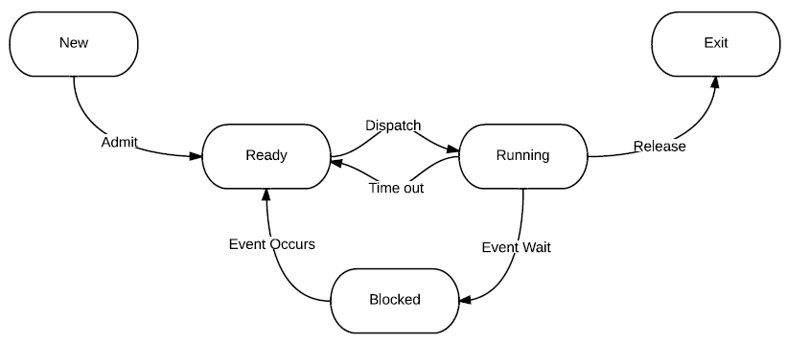
Thread States
// CMSIS-RTOS2 thread states from osThreadGetState()
osThreadInactive – Thread terminated or not started
osThreadReady – Thread is ready to run (waiting in queue)
osThreadRunning – Currently running thread
osThreadBlocked – Waiting (e.g. osDelay, osSemaphoreAcquire)
osThreadTerminated – Thread has exited or was killed
osThreadError – Invalid thread ID or kernel error
Blocked due to:
- osDelay()
- osSemaphoreAcquire()
- osMutexAcquire()
- osMessageQueueGet()
Blocked
Notes:
Thread states like Ready, Running, Blocked etc. can be defined by statements like:
#define READY 1;

Slide 5
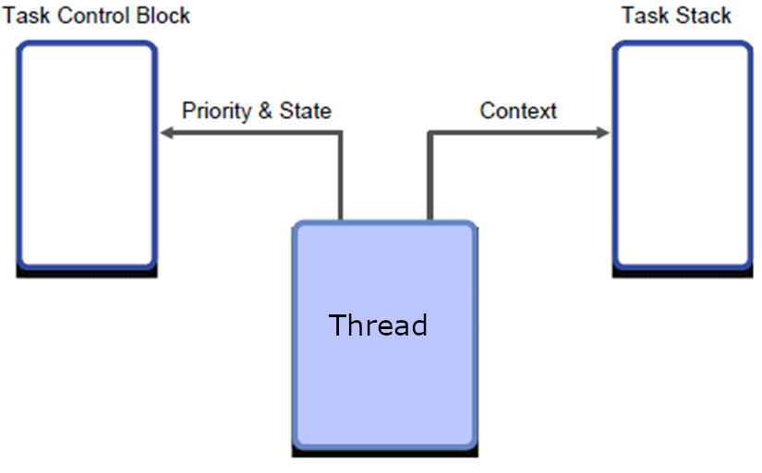
Thread Creation and Deletion
Related functions
Thread creation:
osThreadId_t thread_id;
thread_id = osThreadNew(MyThread, NULL, NULL);
Thread deletion:
osThreadTerminate(thread_id); // Terminates another thread
osThreadExit(); // Terminates the calling thread
Priority
Defined in osThreadAttr_t via .priority = osPriorityNormal
Priorities range from:
osPriorityIdle (lowest)
to osPriorityISR (highest)
Stack size
Set in osThreadAttr_t when creating the thread:
ThreadAttr_t attr = { .stack_size = 512 * 4};
Notes:
Thread creation can assign priority and define user stack size. Threads also have the feature to be deleted if needed.

Slide 6
Thread Creation and Deletion
Passing Parameters to Threads
CMSIS-RTOS2 allows passing a parameter to a thread at creation time:
void led_on_off(void *argument) {
uint32_t pin = (uint32_t)argument;
...
}
osThreadNew(led_on_off, (void *)LED1, NULL);
osThreadNew(led_on_off, (void *)LED2, NULL);
Notes:
At Thread creation, CMSIS-RTOS2 allows you to have multiple instances of the same Thread, passing parameters to a Thread at creation, for example, to specify GPIO pins.
Threads can be created and deleted by other Threads.
The first Thread is commonly used for
Initialization of hardware
Creation of all other Threads
Then deletes itself

Slide 7
Advanced Real-time Scheduling
Recall the aperiodic real-time scheduling policies introduced previously
EDD, EDF and LL
Same priority
No inter-Thread dependency
Aperiodic
Before introducing the CMSIS-RTOS2 scheduler, we will discuss two more real-time scheduling scenarios
Periodic
Prioritized
Notes:
Real time scheduling can be used for aperiodic Threads or periodic Threads.
EDD, EDF, and LL are some algorithms commonly used for aperiodic scheduling. Here, all the Threads are aperiodic and have the same priority and no inter-Thread dependency.
In the next few slides, we will learn about periodic and prioritized Threads and their scheduling algorithms.

Slide 8
Periodic Thread Model
P1
P1
P1
P1
P2
P2
P2
P3
P3
0 1 2 3 4 5 6 7 8 9 10 11 12
Time
Describes real-time computational requirements
Constant process execution time C_{i}
Threads are periodic with period T_{i}
Release time
Thread is released every T_{i} time units and is ready to run
Deadline D_{i} .
Might be related to period T_{i} making analysis easier
Can also be earlier than the end of a period!
Thread | Exec. Time C_{i} | Period T_{i} | Deadline D_{i}
P1 | 1 | 4 | 4
P2 | 2 | 6 | 6
P3 | 3 | 12 | 12
Notes:
For every periodic Thread, the following parameters are specified: Execution time, period, dead line, and release time.
In the above figure, Thread P1 takes 1 unit to execute, the period is 4 units, and the deadline is 4. Release time can be within the period.
Some assumption is: The deadline and period are the same. The interval between two occurrences of Thread 1 may be more than period interval (4 units), but Thread 1 appears in every periodic interval (within every units period).
The release time of a Thread should be such that the Thread can be executed before the dead line. Example, Thread 1 has a dead line of 8, the execution time is 1 unit and it can not be released at time 7.5 unit. It can be released at any time between 4 and 8.

Slide 9
Periodic Scheduling
Goals
Meet all Thread deadlines!
Not always schedulable to meet all deadlines!
Maximize processor utilization (U)
The fraction of time CPU performs useful work
Limit scheduling overhead
Limit context switching overhead
Which ready Thread to run?
Based only on Thread importance?
Would starve consistently low priority Thread unnecessarily
Some common approaches
Earliest deadline first (EDF)
Rate monotonic (RM)
Deadline monotonic (DM) (D_{i}≤T_{i})
Notes:
In periodic scheduling our goals are to meet all the Thread deadlines and maximize processor utilization. The utilization of a processor is the sum of (execution time of Thread/period of Thread) for all Threads. The expression is given in the slide and we will see it again in the next slide.
The scheduler needs to decide which Thread to run next. It can be based on the importance or priority of the Thread without starving any low priority Thread.
Some common algorithms are :
Earliest deadline first (EDF)
Rate monotonic (RM)
Deadline monotonic (DM) (D_{i}≤T_{i}), i.e. dead line is less than or equal to period

Slide 10
Earliest Deadline First
Run the job with the earliest deadline first
Utilization-based schedulability test depends on deadline constraints
Di = Ti : Schedulable if utilization ≤ 100%
Di > Ti : Schedulable if utilization ≤ 100%
Di < Ti : Have to use a more complicated test
Hard to implement such dynamic policy
Run-time scheduler has to keep track of all deadlines, which also depends on Threads’ release time
Sorting by deadline, time complexity: O(n)
Periodic Threads only? Will repeat every hyper-period, the least common multiple of all Thread periods
Notes:
Earliest Deadline First (EDF) runs the Thread with the earliest deadline first. It is a dynamic approach and decided during the running of Threads.

Slide 11
Rate Monotonic
Shortest period first, preemptive
Optimal for workload where deadline = the end of period, i.e., D_{i}=T_{i} .
Assume D_{i}=T_{i} , the utilization bound for RM: U_{max} is*
U_{max} approaches ln2 (around 0.693) as n approaches positive infinity.
If U<U_{max} , 100% schedulable, otherwise, maybe schedulable. An example:
A modified approach: harmonic RM – Thread period can be evenly divide every longer Thread period for example, periods of 10, 20, 40, 80… Bound is 100%
Thread | Execution Time C | Period T | RM Dispatch
P1 | 1 | 8 | First
P2 | 1 | 9 | Second
P3 | 9 | 12 | Third
*Originally proved by CL Liu and JW Layland in 1973. "Scheduling algorithms for multiprogramming in a hard-real-time environment."
Notes:
In this example, although the utilization is below 100%, P3 will miss the deadline in the second period!
But total utilization is equal to the sum (execution time/period). In this example: Total utilization = ( 1/8) + (1/9) + (9/12) = 0.986. Utilization value is not below 0.7796 the U max for 3 Threads. Hence these 3 Threads are not RM schedulable.
Deadline monotonic includes RM, dispatch the Thread with least time from release to deadline.

Slide 12
System Performance During Transient Overload
RM, DM – Each Thread has fixed priority. So?
This priority determines that Threads will be scheduled consistently
Thread A will always preempt Thread B if needed
Thread B will be forced to miss its deadline to help Thread A meet its deadline
EDF – Each Thread has varying priority. So?
This priority depends upon when the Thread’s deadline is, and hence when the Thread becomes ready to run (release time)
Thread B may have higher priority than A depending on release times
To determine whether Thread A or B will miss its deadline we need to know their release times
Can theoretically harness up to 100% of the CPU performance
Notes:
RM and DM (Rate Monotonic and Dead Line Monotonic) are static priority algorithms. Threads are given priority depending on some criteria (in RM: the Thread with shortest period has the highest priority).
The total utilization of the processor under RM is limited for large number of Threads to 69%.
EDF – The Earliest Deadline First algorithm is a dynamic priority algorithm. Thread’s priorities change when approaching the deadline. The total utilization of the processor for this scheme can be up-to 100%.

Slide 13
Our Assumptions
Threads are periodic with period Τ_{i}
Extension 1: Support aperiodic Threads by setting Τ_{i} = min(Τ_{Interarrival i})
Single CPU
OK for some systems, but not all
C_{ContextSwitch} = 0
Scheduler speed. EDF requires ordered list of ready Threads.
Thread state information needs to be swapped
Constant process execution time C_{i}
What if the worst-case time is much slower than average?
Then need a processor fast enough to handle the worst case
Most of the time the processor will be wasting resources
No data dependencies between Threads
Not all Threads are ready to run simultaneously
Some Threads block on other Threads
Notes:
Some of the assumptions for RM and EDF algorithms are:
Threads are periodic
Single CPU is available
Context switching time is zero
The Thread execution time is known and it is fixed value. In reality, the execution time may vary between minimum and worst case value. If we assume the execution time is the Worst case time and assign the Threads as per RM,
(if RM schedulable), all the Threads will meet the deadline. But, when the execution time is average or minimum, the processor will have more free time.
We assume also that the Threads are independent of each other. Results of one Thread are not needed for another Thread. (if this is the case, both the Threads can be made as one big single Thread and scheduling can be done).

Slide 14
Prioritized Scheduling
osThreadAttr_t attr = {
.priority = osPriorityAboveNormal
};
osThreadId_t id = osThreadNew(MyThread, NULL, &attr);
Prioritized Scheduling means that thread with higher priority should be dispatched and can preempt lower priority threads
The problem is dependency. For instance, can a thread in its critical section be preempted?
If no, any problem?
If yes, any problem?
The point of prioritized scheduling is based on the emergency level of the thread, instead of whether it’s in a critical section. But you have to pay extra attention to critical sections as otherwise they may cause conflict between Threads.
Priority inversion
Notes:
Threads may have a priority. A high priority Thread will pre-empt the low priority Thread. But if a low priority Thread is in a critical section, it may not be pre-empted. This can cause special handling.

Slide 15
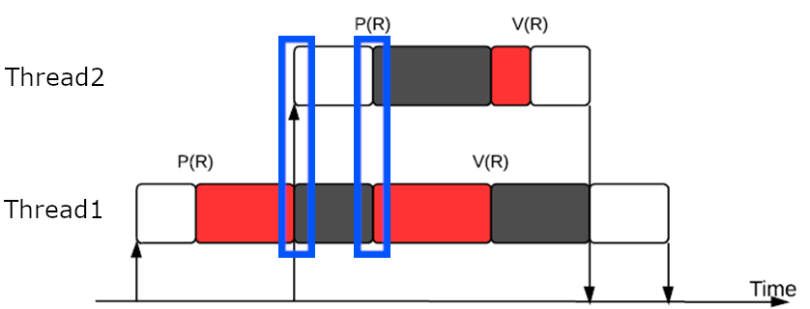
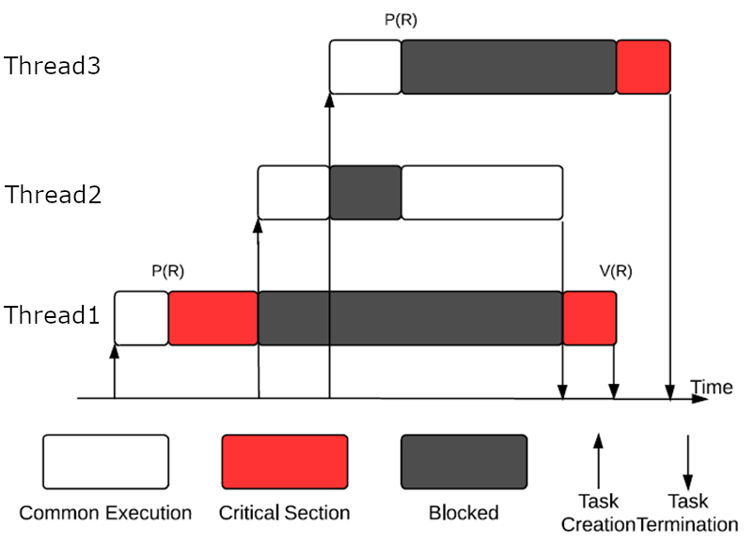
Preemptive Critical Section
Priority(T_{N})>Priority(T_{M}),if N>M
Seems okay?
But what if a higher priority Thread would like to enter the same critical section? P(R) blocks thread 2 if thread 1 has the mutex (recall the requirements for mutex). Still acceptable as contaminating CS may cause even worse disaster, better avoid that and let Thread 1 finish first.
Blocking time seems to be bounded by the maximum length of critical section of lower priority threads. But no. See the second example.
Priority inversion: even though thread 2 is not requesting R, it blocks thread 3!
Notes:
Examples here apply mutex to guarantee exclusive access to a critical section.
A low priority Thread can block a high priority Thread if it is executing a critical section. This is called Priority Inversion.

Slide 16
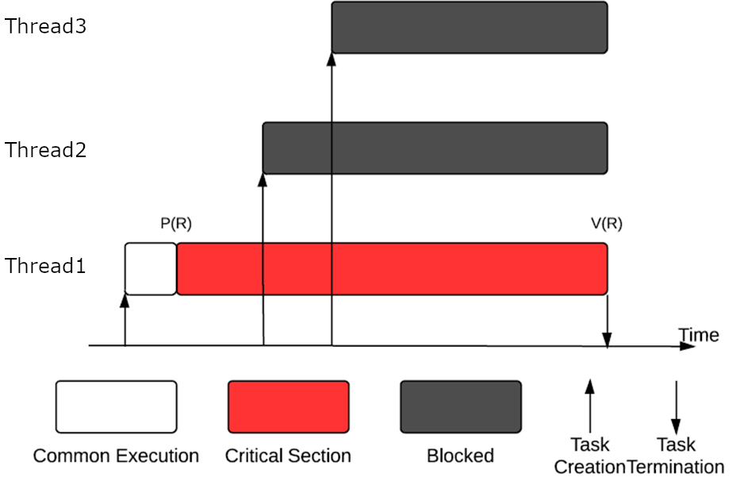
Non-Preemptive Critical Section
Plausible? Can solve previous problem. But…
Thread 3 and 2 are on fire!
Notes:
When a Thread is in a critical section, it can not be pre-empted. In the slide, Thread 3 and Thread 2 are blocked since Thread 1 is executing in the critical section.

Slide 17
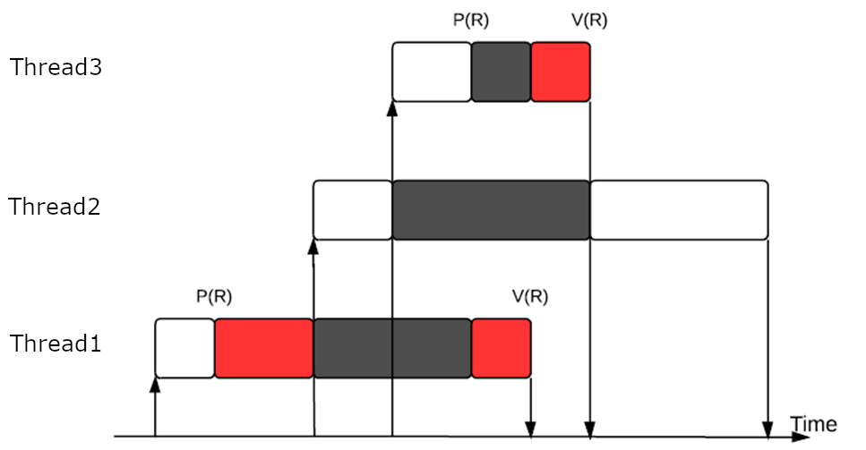
Priority Inheritance
Applied in many RTOS.
Blocking time is now bounded by the maximum (sum) length of critical section of lower priority threads.
The idea is to elevate the priority of low priority thread (if it blocks high priority thread) to the highest priority of threads blocked by it.
And resume its original priority when it exits the critical section.
Thread 1 inherents Thread 3’s priority
Notes:
In many RTOS including CMSIS-RTOS2, the priority of low priority thread (if it blocks high priority Thread) is increased to the highest priority of threads blocked by it.
It then resumes its original priority when it exits the critical section. This is called Priority Inheritance.

Slide 18
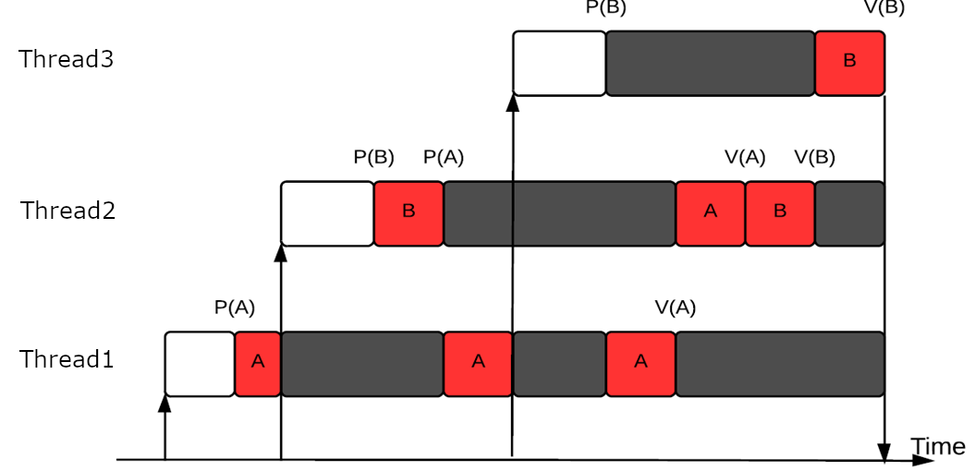
Priority Inheritance
If same priority, then FIFO
Another example:
Thread 2 blocked by thread 1, hence Priority(T₁) = Priority(T₂)
Then, thread 3 is blocked by thread 1, hence Priority(T1) = Priority(T₃), also Priority(T₁)=Priority(T₂)=Priority(T₃) as thread 2 is blocked by thread 1. So Thread 1 continues(FIFO)
After thread 1 releases A, its priority will be resumed. Thread 2 continues.
Similarly, after thread 2 releases B, its priority will be downgraded and thread 3 continues.
Notes:
In the above figure, thread 1 has a lower priority. Thread 3 has the highest priority. But, if thread 1 grabs the critical resource “A”, and if thread 2 needs A, then it is blocked though it has higher priority. Since this happened, as per the priority inheritance principle, thread 1 gets the priority of thread 2. At present you can think that thread 1 and 2 are in FIFO (because they both have the same priority. Since thread 1 entered the FIFO queue, it will continue).
After thread 1 releases A, its priority comes down to original value.

Slide 19
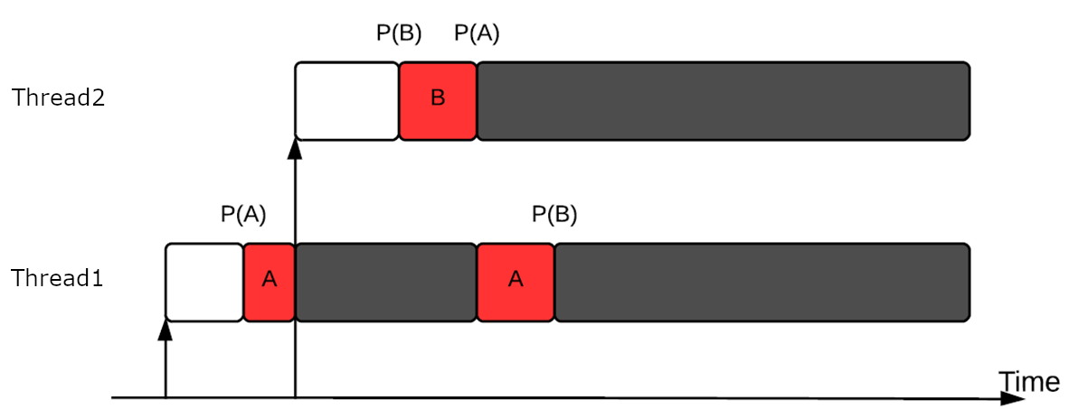
Deadlock Caused by Priority Inheritance
Unfortunately, priority inheritance is not perfect. Consider the following example:
Recall Coffman conditions for deadlock. Deadlock here!
Notes:
If there are two critical shared resources, priority inheritance will not solve the problem, it will lead to a dead-lock problem.
Thread 1 has critical resource A and thread 2 has critical resource B. Next, thread 1 needs B and thread 2 needs A. This is where dead-lock occurs.

Slide 20
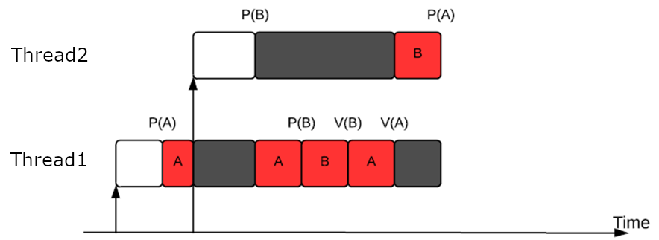
Priority Ceiling
Improvement on priority inheritance. But not implemented in the CMSIS-RTOS2.
Define the priority ceiling for a resource: PC(R) are the highest priority processes that may request mutual exclusive access to R
Priority ceiling accepts requests to enter any critical section only if Thread A’s priority is larger than PC (all resources accessed by Threads other than A). This solves deadlocks by preventing circular wait conditions
If thread A is blocked due to this, then the priority of thread B which is blocking thread A, will be elevated to A’s priority (if A is the highest) as the usual priority inheritance protocol.
Another improvement is that it reduces the blocking time to at most the length of one critical section of a low priority Thread.
Notes:
When thread 2 requests B, it is rejected as thread 1 is accessing A and PC(A) is max(T1,T2)=T2 and thread 2 does not have a priority larger than its own priority. So thread 1 continues (with priority of t2 as thread 2 is blocked by it) and can request B as other threads are not accessing any critical section (no priority ceiling). After thread 1 releases A and B, its priority resumes and thread 2 can carry on as all priority ceilings are removed.
Here each resource is assigned a priority ceiling, which is a priority equal to the highest priority of any thread which may request the resource.
This solves the deadlock and prevents circular wait. It is a dynamic priority scheduling technique, but this is not implemented in CMSIS-RTOS2.

Slide 21
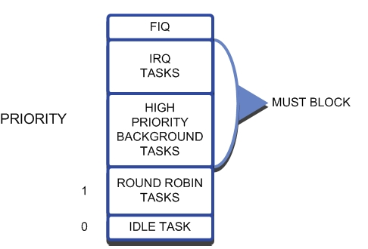
Thread Priority Scheme in CMSIS-RTOS2
CMSIS-RTOS2 supports priority-based preemptive scheduling, with built-in support for priority inheritance when using mutexes.
Thread priority is set using osThreadAttr_t when creating a thread:
osThreadAttr_t attr = { .priority = osPriorityAboveNormal };
osThreadNew(MyThread, NULL, &attr);
Priority can also be changed after creation using:
osThreadSetPriority(thread_id, osPriorityHigh);
Larger priority enum = higher priority
Enum values like osPriorityLow, osPriorityNormal, osPriorityHigh
osPriorityISR is reserved for interrupts
Notes:
The CMSIS-RTOS2 mutex will be introduced in the next module.
CMSIS-RTOS2 supports priority scheduling and applies priority inheritance policy with mutexes.
Possible to alter the priority of a Thread after creation.
Higher number, higher priority, from 0 to 255
A FIFO queue for each priority
The figure in the slide shows the priority. From priority low to high: Idle Thread, Round Robin Threads, High Priority background Thread, IRQ (interrupt request Threads),
Preemption: Higher-priority threads automatically preempt lower-priority onesRound-robin scheduling occurs between threads at the same priority levelIdle thread runs only when no other threads are readyPriority inheritance is supported with:cCopyEditosMutexAttr_t attr = { .attr_bits = osMutexPrioInherit };osMutexNew(&attr);

Slide 22
Scheduling Options in CMSIS-RTOS2
Pre-emptive scheduling
Each Thread has a different priority and will run until it is pre-empted or has reached a blocking OS call.
Round-Robin scheduling
Each Thread has the same priority and will run for a fixed period, or time slice, or until it has reached a blocking OS call.
Quantum is determined by the rtx_config.h file: #define OS_ROBIN_TIMEOUT× Timer tick value. For example, by default, the time quantum is 10000µs ×5 = 50000µs=50ms.
If quantum expired, state will be changed to READY.
Co-operative multi-Threading
Each Thread has the same priority and the Round-Robin is disabled. Each Thread will run until it reached a blocking OS call or uses the osDelay(); call.
By default, CMSIS-RTOS2 with RTX5 uses prioritized preemptive scheduling with round-robin time-slicing among threads of equal priority.
Notes:
Taking deadlines into consideration is always a challenge for operating system design.
CMSIS-RTOS2 scheduling options:
Pre-emptive scheduling with a different priority for each Thread. Sometimes the OS can pre-empt a Thread.
Round robin scheduling: All Threads have the same priority. Each Thread will run for a short fixed period of time. This quantum can be fixed by RTX Conf CM.c command. A round robin queue is maintained to make sure all the Threads get to execute.
Co-operative Multi-Threading: here all Threads have the same priority. No round robin queue. Each Thread will run till there is a blocking OS call.
CMSIS-RTOS2 allows only Round-Robin Pre-emptive ( or Prioritized Round Robin) scheduling.
RTX does not provide aperiodic or periodic deadline scheduling.

Slide 23
Simple Time Management APIs
Besides the scheduling options, CMSIS-RTOS2 can also manage time through the following APIs:
Get current time
uint32_t now = osKernelGetTickCount();
Returns current OS time measured in ticks
Simple delay
void os_dly_wait (unsigned short delay_time)
Turn the state of calling Thread into WAIT_DLY
Actual delay time = delay_time × timer tick value
After the delay time, turn the state of the Thread back to READY
Make sure you have the correct timer clock value
Periodic Thread execution
Set the interval within the Thread by calling void os_itv_set (unsigned short interval_time) first
Actual delay time = interval_time × timer tick value
Then change the to WAIT_ITV by calling void os_itv_wait (void) inside the Thread
Notes:
CMSIS-RTOS2 provides time management as: Get current time, simple delay and periodic Thread execution. The operating system decides the Thread execution periods based on the interval time set.

Slide 24
Simple Time Management APIs
Cooperate function
osThreadYield();
Thread calling this function will voluntarily give up its current possession of CPU and allow next ready Thread with same priority to run.
No Thread switch if the next ready Thread has a lower priority than the calling Thread.
Timer functions
CMSIS-RTOS2 supports software timers for delayed or periodic execution
Create a timer with:
osTimerId_t timer_id;
timer_id = osTimerNew(callback_fn, osTimerOnce, argument, NULL);
Start the timer:
osTimerStart(timer_id, delay_ticks);
Notes:
Also possible to assign an ID to a timer and kill specific a timer.
CMSIS-RTOS2 supports cooperate function and user time function.
Thread calling a cooperate function will voluntarily give up its current possession of the CPU and allow the next ready Thread with same priority to run.
In the user timer function, the time is first set, when it reaches zero, the next Thread is called.

Slide 25
Other Control Functions in CMSIS-RTOS2
Scheduler lock – stops Thread switching, though ISRs can still execute
If you want your code to run as a contiguous block, (critical section for example), it is a good idea to temporally stop the scheduler.
osKernelLock();
Disables kernel timer interrupts, stopping Thread switching
osKernelUnlock();
Enables kernel timer interrupts, allowing Thread switching
Power management
Use osKernelSuspend() and osKernelResume() in Idle Thread for low-power operation:
uint32_t ticks = osKernelSuspend();
Calculates for how many ticks the system can sleep
Locks Thread scheduler
Use this in idle_Thread to determine when to set wake-up timer before sleeping (wfi instruction)
osKernelResume(ticks);
Updates system timer with sleep duration (number of ticks)
Unlocks Thread scheduler, allowing normal scheduling
Use this in idle_Thread to resume
Notes:
CMSIS-RTOS2 has two control functions: Scheduler Lock and Power Management.
Scheduler lock prevents Threads switching (though, Interrupts can be allowed).
Power management is used to make the CPU hibernate or sleep for a fixed time.

Slide 26
Next
Lab
Sharing data in CMSIS-RTOS2

